Slide 1
Ch1: Science Inquiry
Sample Exam Questions

Slide 2


Slide 3
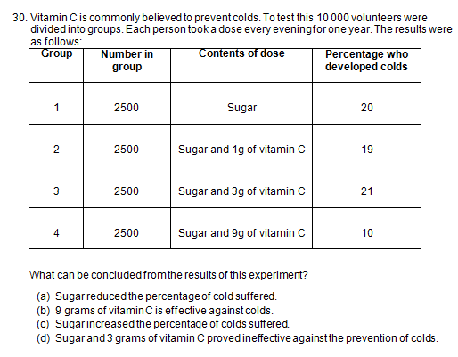

Slide 4
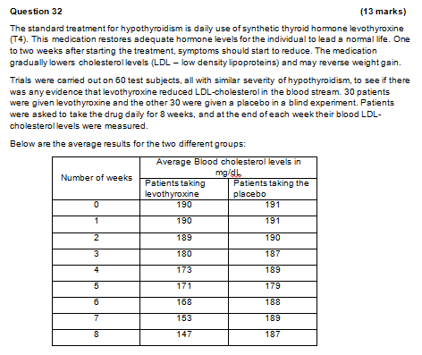

Slide 5
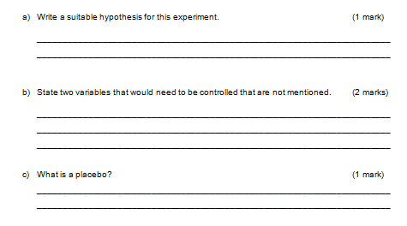

Slide 6
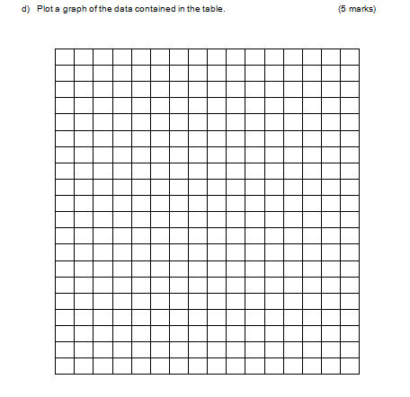

Slide 7
